Slide 1


SciCrunch X UMSI
Making biology more accessible.
Aaron Cheng, Kyle Essenmacher, and Demery Gijsbers

Slide 2
Project Goals
Understand the process that biologists go through to find resources
Improve accessibility to specific and niche information
Streamlining user flow to increase efficiency

Slide 3
Methods
1
Competitive Analysis (Research)
2
Heuristic Evaluation (Research)
3
Usability Testing (Design)
4
A/B Testing (Validation)
Notes:
Asking users to do 3 tasks on original site and evaluating the usability in qualitative way
Evaluating website based on 7 aspects that can apply to any search portal and rating on scale of 1-5
Analyzing website compared to others like it

Slide 4
Research

Slide 5
Competitive Analysis
Heuristic Evaluation
Direct and indirect competitors
Similar design approach
User flow - not as smooth
Nielsen’s 10 Usability Heuristics
Incongruences
Information overload
Accessibility
Page inconsistency

Slide 6

Persona
Anna Mitchell
Biology grad student submitting research articles to publications
Goal: Search & add resources to research articles in a timely manner
75%
23%
83%
Desire to Improve Research Reproducibility
Tech Savvy
Major Time Budget
Notes:
Based off of all our research. It is the persona that our team would always go back to when designing our prototypes.

Slide 7
UX Requirements
Reduce information overload to make
search results page more accessible
Re-categorize Community Resources to
provide search results in fewer steps
Clear up affordance when adding RRID to collections &
make the feature accessible for users that cannot login
Notes:
Users in China specifically cannot login since the Great Firewall of China blocks services that use Google Authentication

Slide 8
Design

Slide 9
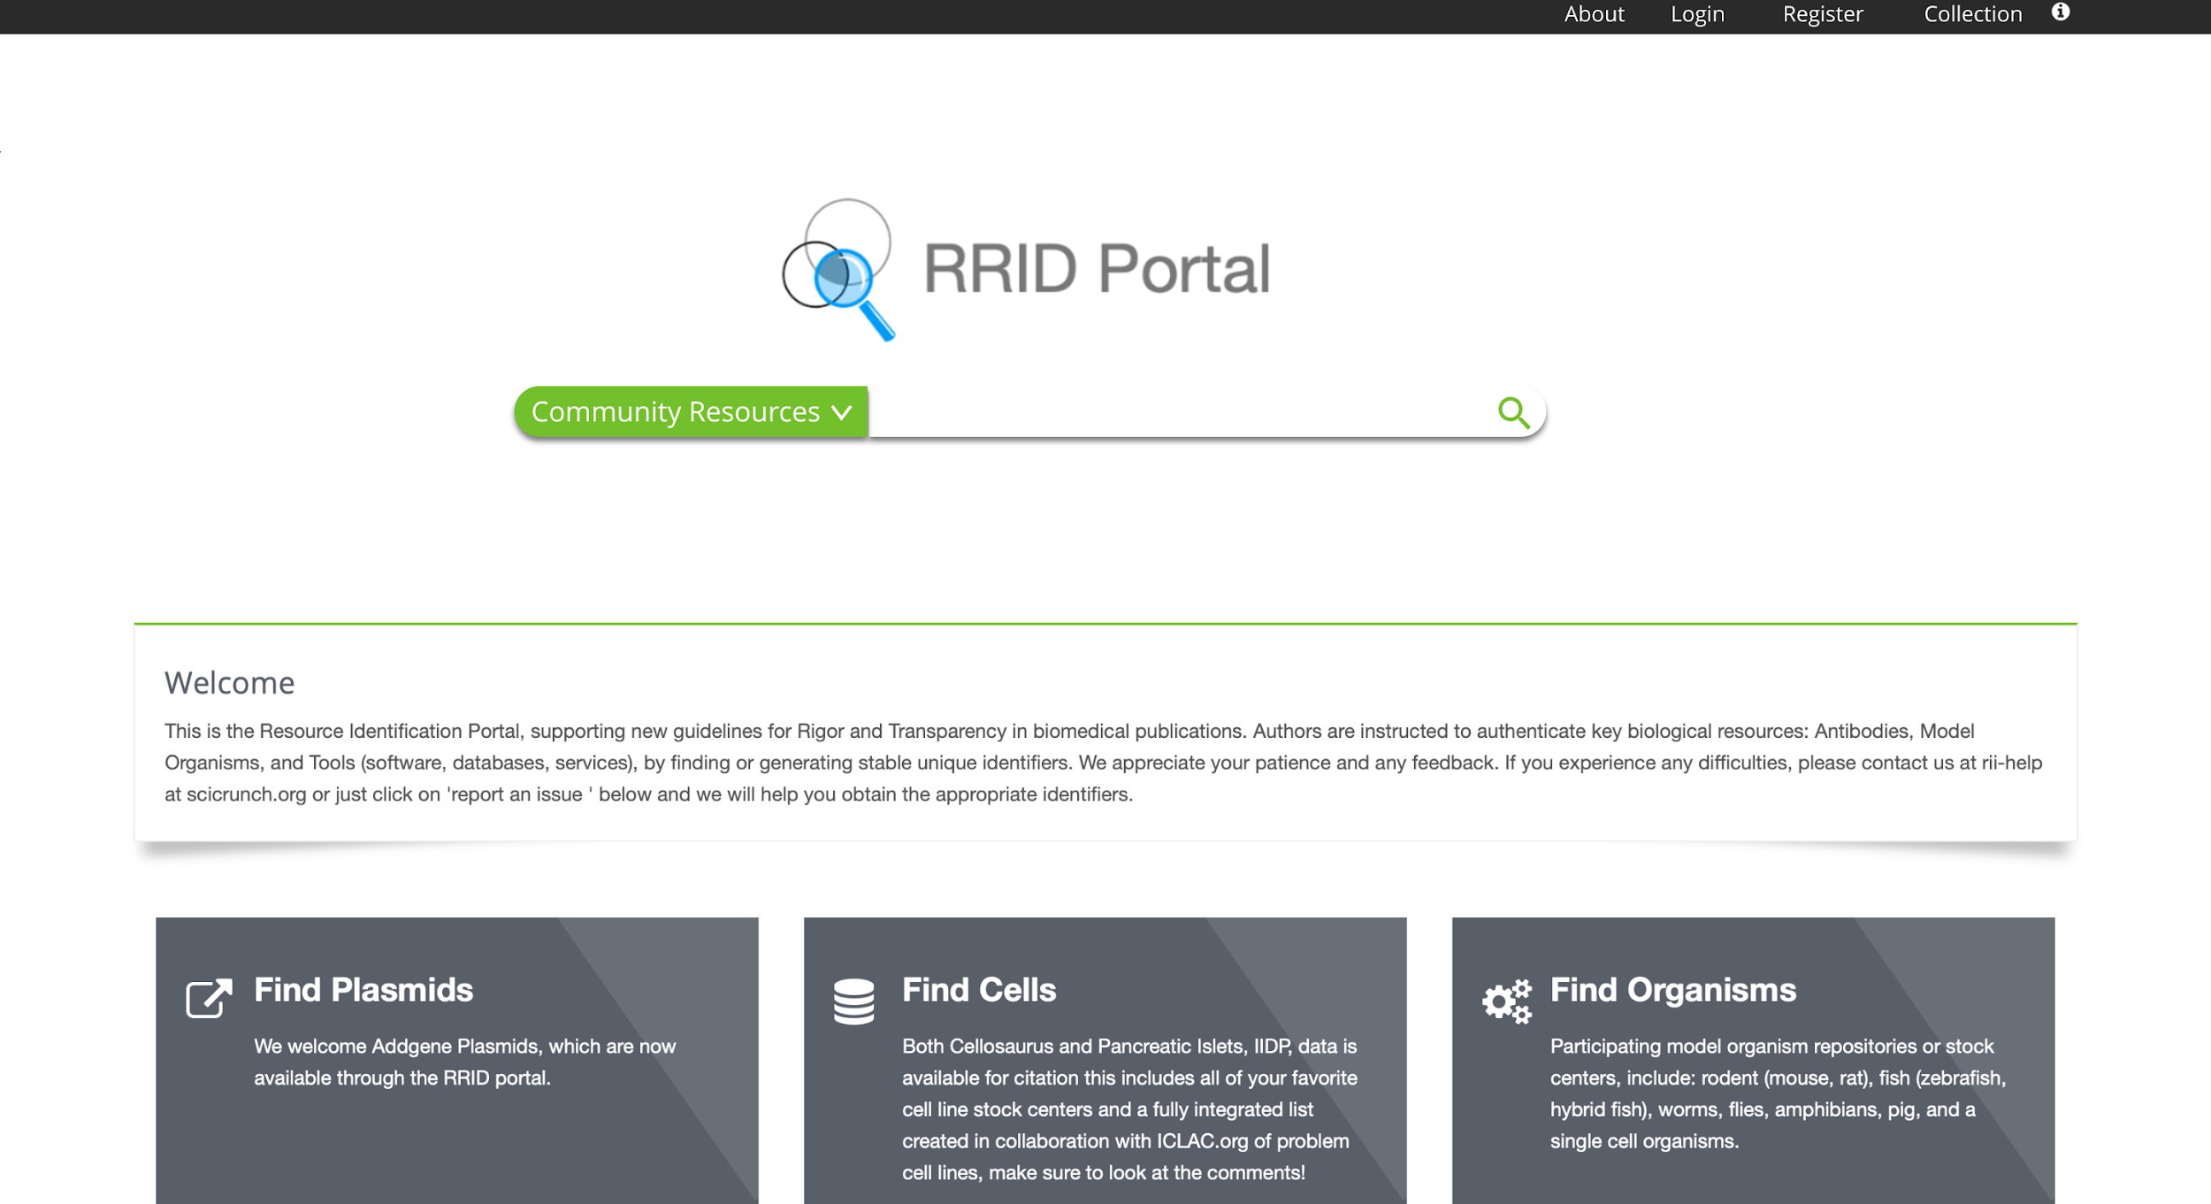
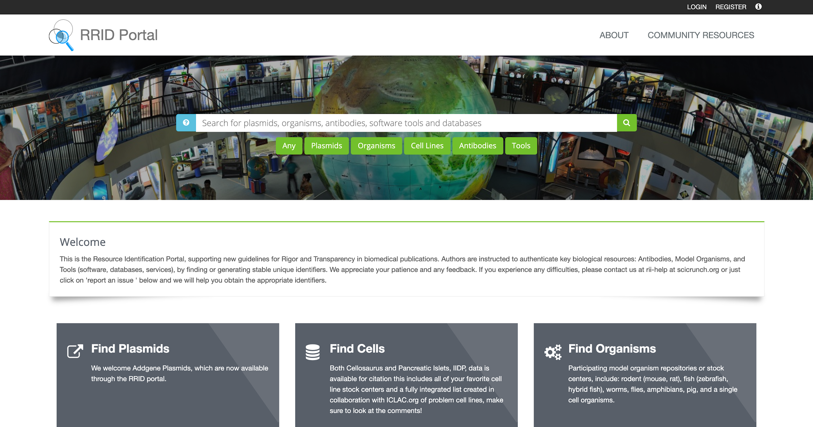
RRID Portal Home Page
After
Before

Slide 10
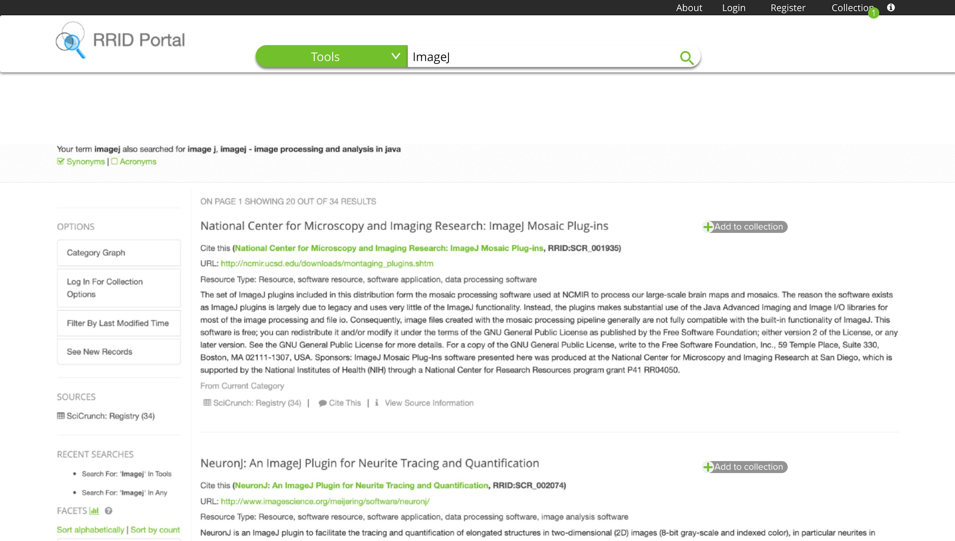
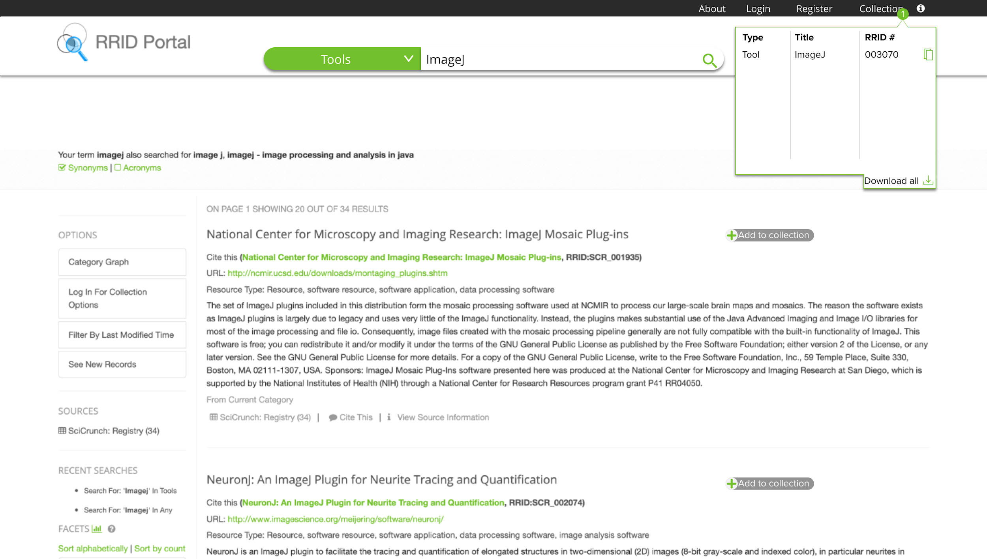
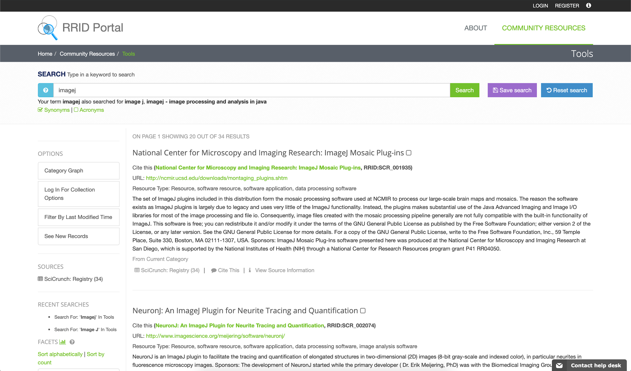
RRID Portal Search
Results Page
After
Before

Slide 11
Validation

Slide 12
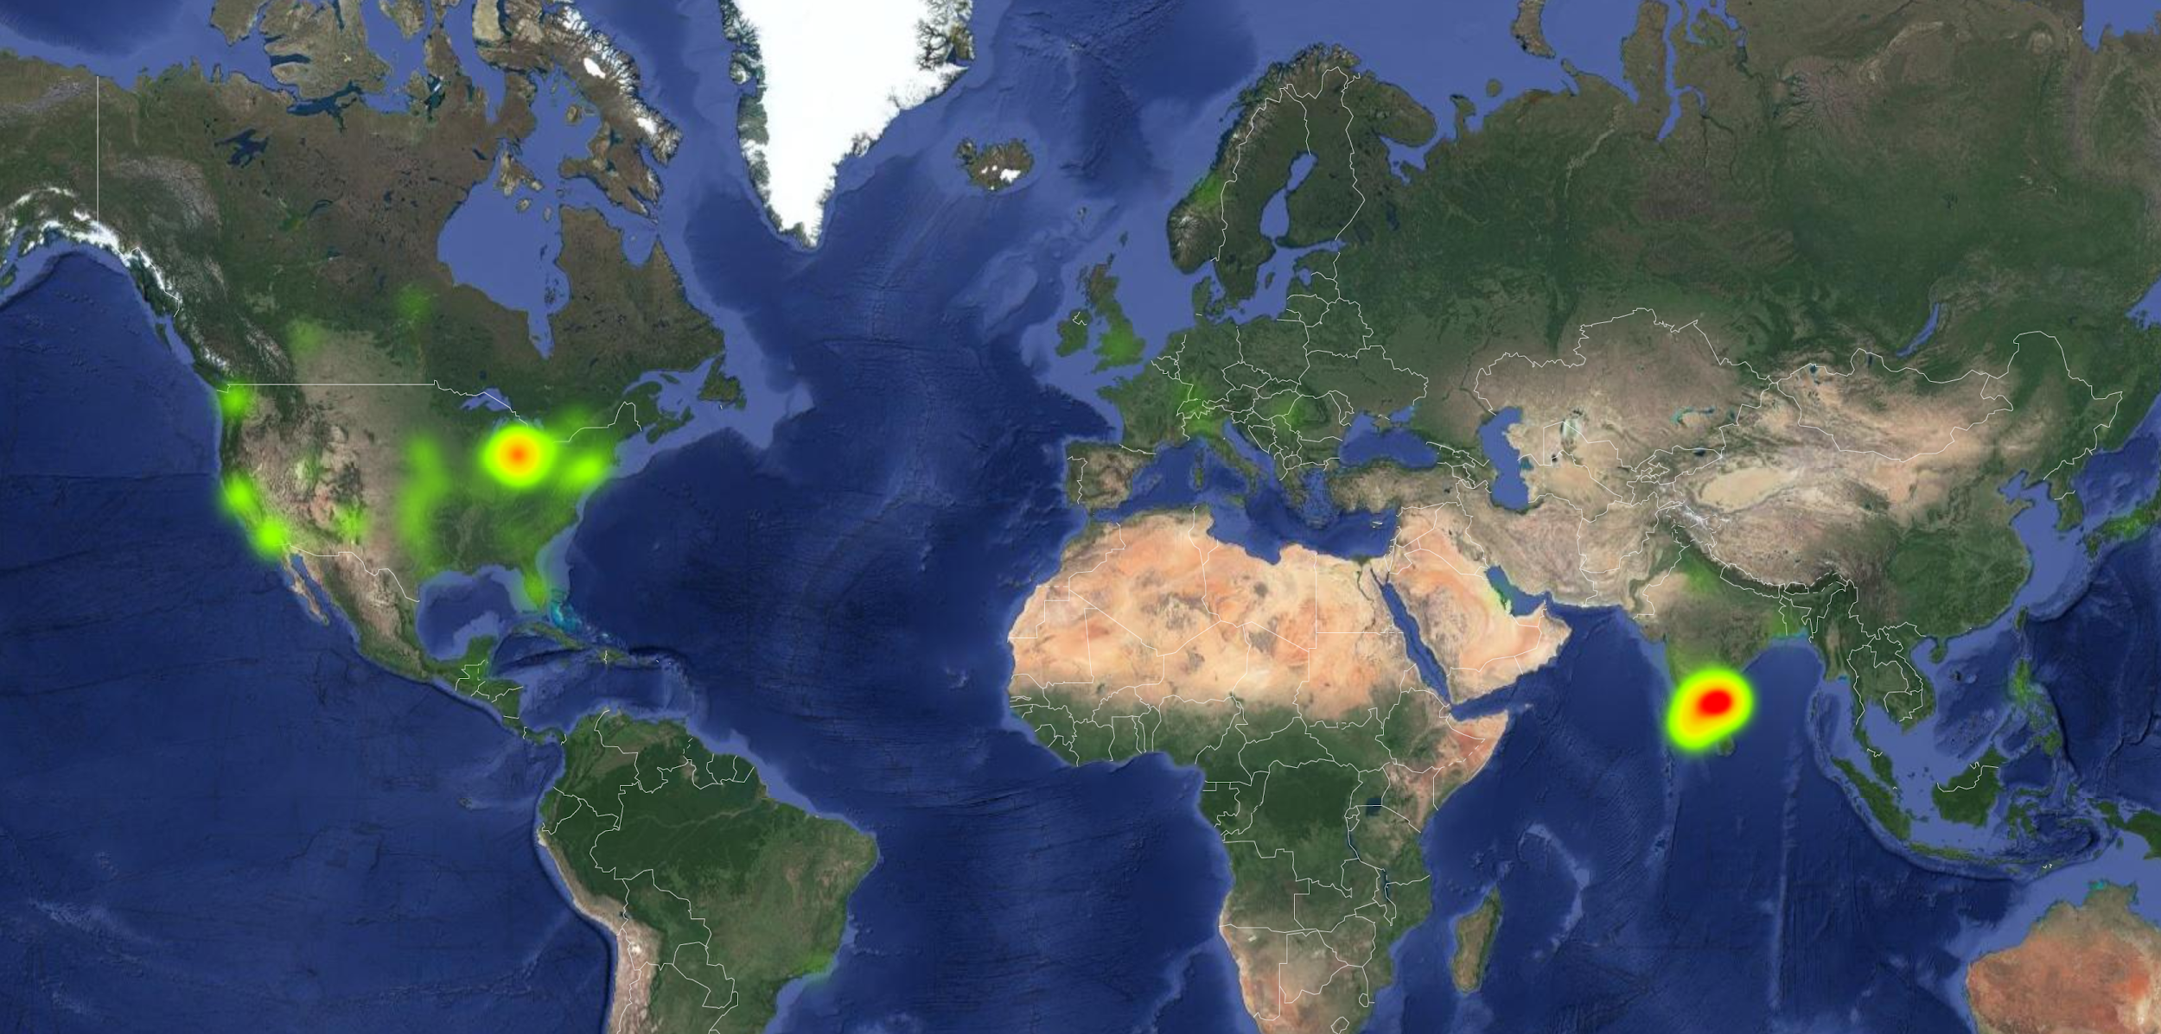
A/B Testing
n = 230 survey responses

Slide 13
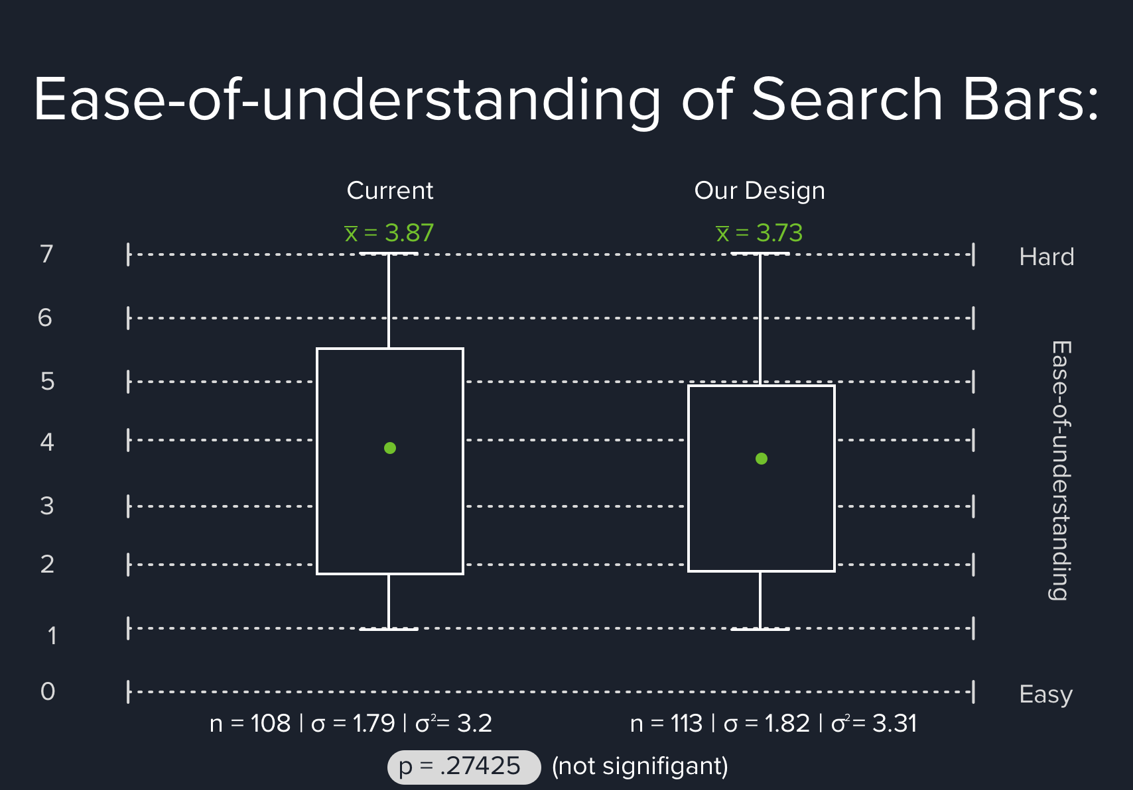
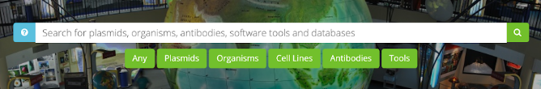


Slide 14
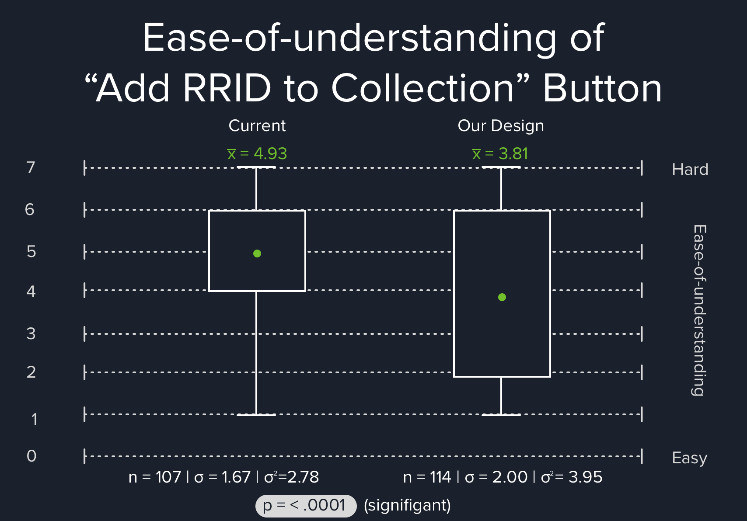
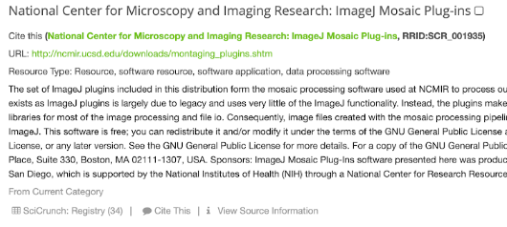
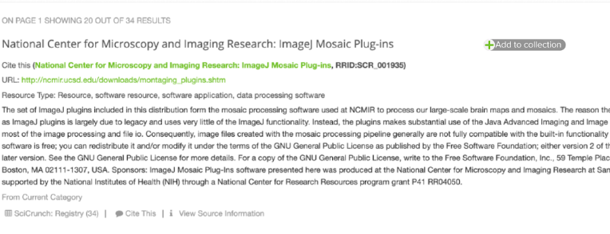

Slide 15
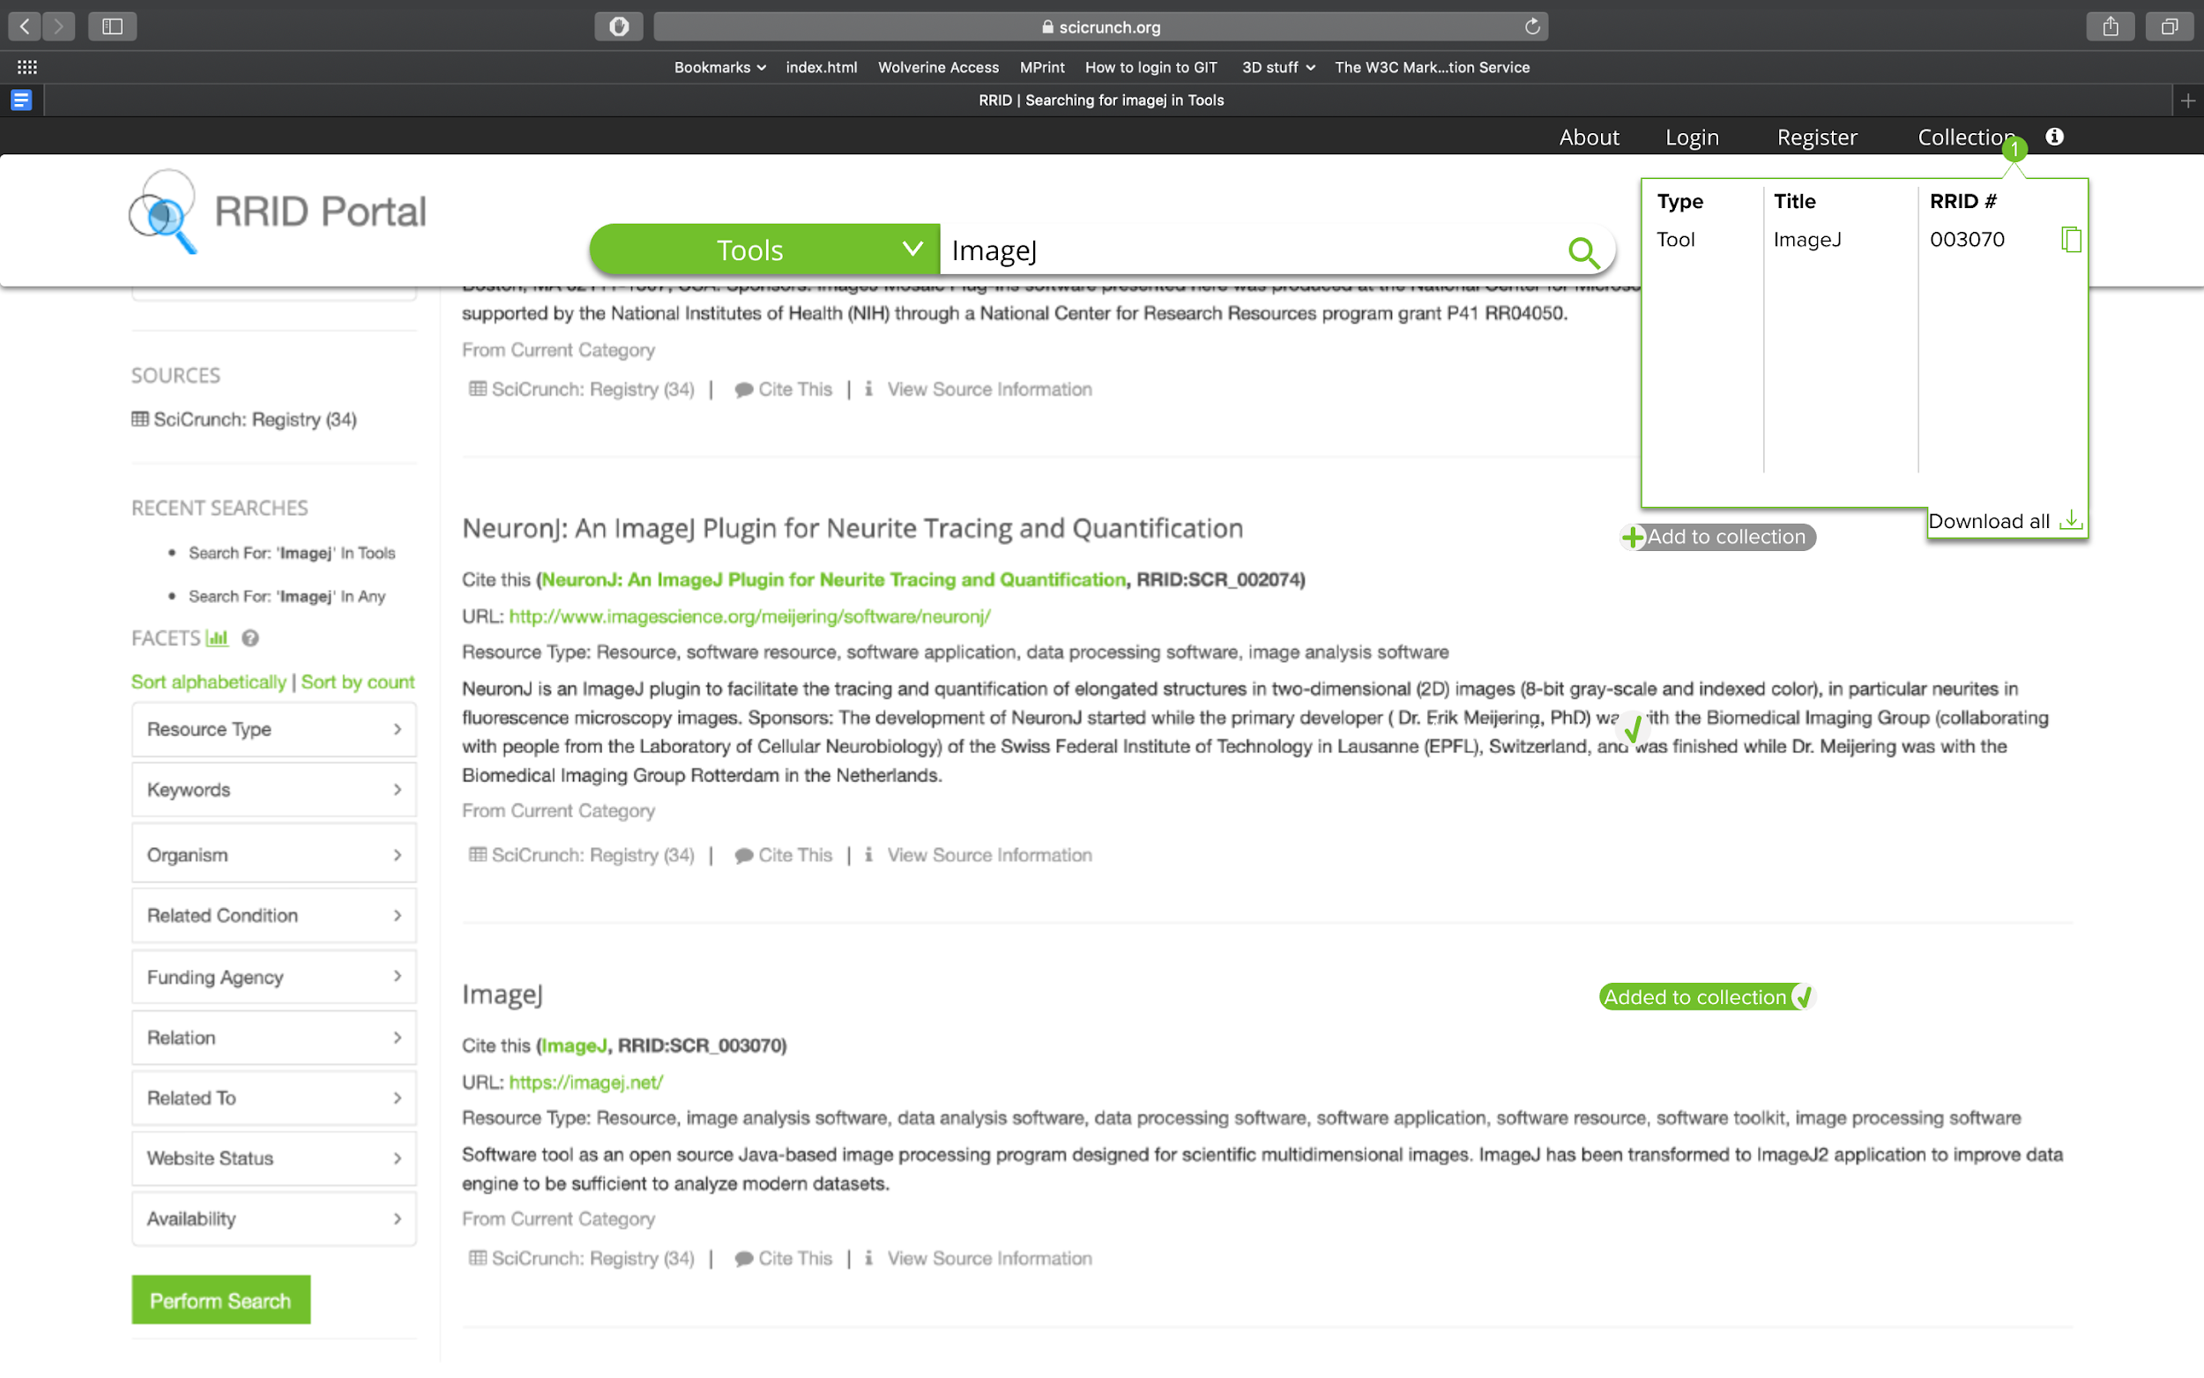
Recommendations
Add RRID to collections
Shopping cart style
Save and download without logging in
Search bar
Sticky

Slide 16
Thanks!

